Slide 1
ClauseIQ
Machine Learning-Based Contract Clause Classification
and Intelligent Search System
Interim Project Presentation
MOHAMMED FARHAN K
MCA | Department of Computer Applications | Reg. No: MAC25MCA-2042
Mar Athanasius College of Engineering (MACE), Kothamangalam
Notes:
Good morning respected evaluators and guide Dr. Sonia Abraham.
I am Mohammed Farhan K, presenting the Interim Project Presentation for my MCA mini project: 'ClauseIQ – Machine Learning-Based Contract Clause Classification and Intelligent Search System'.
In our first presentation, we proposed the conceptual framework and dataset exploration. Today, for this interim review, I am presenting the verified empirical results of our completed machine learning pipeline. This includes training and tuning four classifiers, evaluating them on our held-out test set, selecting Logistic Regression based on our primary metric, analyzing errors with a full 41x41 confusion matrix, and demonstrating our intelligent search prototype.

Slide 2
MOTIVATION
PROBLEM & MOTIVATION
Operational Bottlenecks in Legal Contract Review
MANUAL REVIEW
Large contracts require time-consuming clause identification.
KEYWORD SEARCH
Exact keyword search misses variations in legal wording.
CLASSIFICATION CHALLENGE
41 legal clause categories are highly imbalanced.
GOAL: Automatically classify contract clauses and retrieve relevant clauses using classical ML.
ClauseIQ — Contract Clause Classification & Intelligent Search
Dept. of Computer Applications, MACE | Slide 2
Notes:
Legal contract review is currently bottlenecked by three main challenges:
First, manual review across lengthy legal contracts is exhausting, slow, and prone to human error.
Second, standard keyword search tools fail because lawyers use varying drafting conventions and synonyms—for example, 'limitation of liability' versus 'aggregate exposure'.
Third, automatic classification is difficult because contract clauses span 41 distinct categories that exhibit severe statistical imbalance.
Our project goal is to build a practical, lightweight classical machine learning system that automatically classifies clauses into 41 categories and provides intelligent semantic clause retrieval.

Slide 3
SCOPE AUDIT
PROJECT OBJECTIVES & CURRENT SCOPE
Deliverables Planned vs. Actually Completed at Interim Milestone
OBJECTIVES
1. Classify clauses into 41 categories
2. Build TF-IDF based clause search
3. Evaluate multiple ML models
CURRENTLY COMPLETED
✓ Dataset + preprocessing
✓ TF-IDF feature extraction
✓ 4 ML models trained & tuned
✓ Model evaluation
✓ Model selection
✓ Search prototype
✓ FastAPI prototype
ClauseIQ — Contract Clause Classification & Intelligent Search
Dept. of Computer Applications, MACE | Slide 3
Notes:
This slide clearly establishes our interim project milestone.
Our overall objectives are threefold: classify clauses into 41 categories, build a TF-IDF clause search engine, and rigorously evaluate multiple ML models.
For this interim review, we have completed the entire machine learning core: data cleaning, TF-IDF vectorization, training and tuning all four candidate classifiers, evaluating them on the held-out test set, selecting our model, building our search prototype, and implementing our FastAPI backend. The frontend UI and database persistence are scheduled for our final phase.

Slide 4
DATASET
DATASET SPECIFICATIONS
CUAD-Derived Legal Contract Clause Corpus
510
CONTRACTS
12,204
CLAUSE RECORDS
41
CLAUSE CATEGORIES
3
CORE FEATURES
DATASET ATTRIBUTES
contract_id | clause_text | category
100% Complete: 0 missing values • 0 empty strings • 0 duplicate rows
ClauseIQ — Contract Clause Classification & Intelligent Search
Dept. of Computer Applications, MACE | Slide 4
Notes:
Slide 4 shows our verified dataset figures.
Our dataset is derived from the Contract Understanding Atticus Dataset (CUAD v1).
It contains 510 commercial contracts, yielding exactly 12,204 labeled clause records across 41 categories.
The schema is minimal and clean, with 3 columns: contract_id, clause_text, and category.
Through automated validation in src/clean_dataset.py, we verified 100% data completeness: exactly zero missing values, zero empty strings, and zero duplicates.

Slide 5
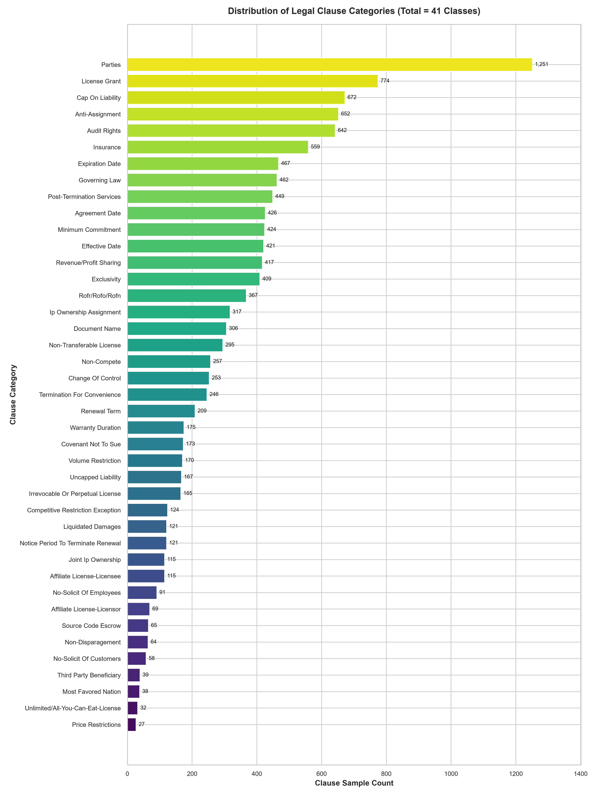
DATA PROFILING
EXPLORATORY DATA ANALYSIS
Corpus Distribution and Severe Class Imbalance
CLASS IMBALANCE
Largest Category:
Parties — 1,251
Smallest Category:
Price Restrictions — 27
Imbalance Ratio:
46.33 : 1
Macro-F1 is more informative than Accuracy for this dataset.
ClauseIQ — Contract Clause Classification & Intelligent Search
Dept. of Computer Applications, MACE | Slide 5
Notes:
Slide 5 highlights our exploratory analysis of class distribution.
The dataset exhibits extreme class imbalance: 'Parties' is the largest category with 1,251 instances, while 'Price Restrictions' has only 27 instances.
This creates a severe imbalance ratio of 46.33 to 1.
Because of this skew, standard accuracy is misleading: a model could achieve over 70% accuracy by only predicting common boilerplate while missing rare, high-consequence clauses.
Therefore, Macro-F1—which weights all 41 classes equally—is our primary evaluation metric.

Slide 6
PREPROCESSING
DATA PREPROCESSING PIPELINE
Standardized Text Normalization for Legal Terminology
RAW CLAUSE
LOWERCASE
REMOVE URL/EMAIL
CLEAN NOISE
NORMALIZE SPACES
CLEAN TEXT
TEXT TRANSFORMATION EXAMPLE
Before:
"This AGREEMENT shall be governed by Delaware! Contact legal@clauseiq.com or https://..."
After:
"this agreement shall be governed by delaware contact for terms"
ClauseIQ — Contract Clause Classification & Intelligent Search
Dept. of Computer Applications, MACE | Slide 6
Notes:
Slide 6 presents our text cleaning pipeline implemented in src/text_cleaner.py.
Raw clauses undergo case-folding, URL and email removal via regex, noise filtering while preserving legal punctuation, and whitespace normalization.
The example shows how web links and irregular casing are cleaned into standardized tokens while preserving all substantive legal terms like 'governed by delaware'.

Slide 7
FEATURE EXTRACTION
TF-IDF FEATURE ENGINEERING
Sparse Vector Space Configuration & Anti-Leakage Protocol
10,000
FEATURES
(1, 2)
N-GRAMS
TRUE
SUBLINEAR TF
2
MIN DF
0.95
MAX DF
TRAIN TEXT → FIT TF-IDF → TEST TEXT → TRANSFORM
Vocabulary fitted only on training data to prevent data leakage.
Unigrams + Bigrams capture compound legal collocations ('governing law', 'audit rights').
ClauseIQ — Contract Clause Classification & Intelligent Search
Dept. of Computer Applications, MACE | Slide 7
Notes:
Slide 7 illustrates our feature extraction settings:
We configure 10,000 maximum features, unigrams and bigrams (1,2), sublinear TF scaling (1 + log(tf)), minimum document frequency of 2, and maximum document frequency of 0.95.
Bigrams are essential to capture two-word legal expressions like 'governing law' and 'prior written consent'.
Importantly, to prevent data leakage, the vectorizer was fitted strictly on the training partition and applied to the test partition via transform().

Slide 8
DATA SPLIT
DATASET PARTITIONING STRATEGY
Stratified 80/20 Clause-Level Partition Preserving 41 Classes
12,204 TOTAL CLAUSES
80 / 20 STRATIFIED SPLIT
9,763
TRAIN SAMPLES (80%)
2,441
TEST SAMPLES (20%)
41 classes preserved • random_state = 42 • Clause-level split — NOT contract-level
ClauseIQ — Contract Clause Classification & Intelligent Search
Dept. of Computer Applications, MACE | Slide 8
Notes:
Slide 8 illustrates our dataset partition:
We performed an 80/20 stratified split with random_state=42, partitioning our 12,204 clauses into 9,763 training samples and 2,441 held-out test samples.
Stratification ensures all 41 categories maintain identical proportions in both splits.
Important clarification: this is a clause-level stratified split, not a contract-level split. All four models were evaluated on the exact same 2,441 held-out test instances.

Slide 9
MODELS
FOUR MACHINE LEARNING MODELS
Candidate Architectures for High-Dimensional Sparse Text
LOGISTIC REGRESSION
Linear classifier
Softmax decision surface with L2 regularization.
LINEAR SVM
Maximum-margin classifier
Separating hyperplane optimized for sparse text.
NAIVE BAYES
Probabilistic baseline
Fast generative word frequency baseline.
RANDOM FOREST
Tree ensemble
Decision tree ensemble evaluating non-linear bagging.
Same TF-IDF Features • Same Training Set • Same Held-Out Test Set
ClauseIQ — Contract Clause Classification & Intelligent Search
Dept. of Computer Applications, MACE | Slide 9
Notes:
Slide 9 presents our four candidate models:
Logistic Regression: a multinomial linear model with L2 regularization.
Linear SVM: a maximum-margin hyperplane classifier well-suited for sparse text.
Naive Bayes: a fast probabilistic generative baseline.
Random Forest: an ensemble of decision trees to test non-linear bagging on text.
Crucially, all four models were trained on the same training set and evaluated on the exact same held-out test set.

Slide 10
TUNING
TRAINING & HYPERPARAMETER TUNING
Systematic Cross-Validation Results from Repository
MODEL | METHOD | BEST PARAMETER
Naive Bayes | GridSearchCV (5-Fold) | alpha = 0.01
Random Forest | RandomizedSearchCV (3-Fold) | 200 trees, max_depth = 50
Linear SVM | GridSearchCV (3-Fold) | C = 0.1
Logistic Regression | L2 Regularization | C = 1.0
Optimization Metric: Macro-F1 (Balances evaluation across all 41 categories)
ClauseIQ — Contract Clause Classification & Intelligent Search
Dept. of Computer Applications, MACE | Slide 10
Notes:
Slide 10 summarizes the tuning parameters for all four classifiers.
All tuning was performed on the training partition using StratifiedKFold cross-validation optimizing for Macro-F1:
For Naive Bayes, GridSearchCV selected alpha = 0.01.
For Random Forest, RandomizedSearchCV selected 200 estimators and max_depth of 50.
For Linear SVM, grid search selected C = 0.1.
For Logistic Regression, L2 regularization with C = 1.0 and balanced class weights was utilized.

Slide 11
SOURCE CODE
IMPLEMENTATION CODE
Verified Pipeline Logic from Repository (src/train_baseline.py)
# TF-IDF Feature Extraction
vectorizer = TfidfVectorizer(max_features=10000, ngram_range=(1, 2))
X_train = vectorizer.fit_transform(X_train_text)
X_test = vectorizer.transform(X_test_text)
# Model Training with Balanced Weights
clf = LogisticRegression(max_iter=1000, class_weight="balanced")
clf.fit(X_train, y_train)
# Inference on Held-Out Test Set (N=2,441)
y_pred = clf.predict(X_test)
DATA → TF-IDF → MODEL → PREDICTION
ClauseIQ — Contract Clause Classification & Intelligent Search
Dept. of Computer Applications, MACE | Slide 11
Notes:
Slide 11 shows the actual production code from our repository in src/feature_extraction.py and src/train_baseline.py.
First, we vectorize raw text using TfidfVectorizer with 10,000 features and unigram-bigram pairing. Notice that fit_transform is applied exclusively to X_train_text, while X_test_text is transformed using transform() to prevent data leakage.
Second, LogisticRegression is initialized with class_weight='balanced' to compensate for the 46:1 class imbalance.
Finally, the model fits on X_train and predicts on the 2,441 test samples.

Slide 12
EVALUATION
MODEL EVALUATION RESULTS
Held-Out Test Set Benchmark (N = 2,441, 41 Classes)
Model | Accuracy | Precision | Recall | Macro-F1
Logistic Regression | 71.90% | 64.81% | 66.22% | 64.74%
Linear SVM | 72.63% | 63.23% | 66.65% | 64.18%
Naive Bayes | 69.27% | 60.24% | 58.67% | 58.53%
Random Forest | 65.46% | 55.27% | 59.04% | 56.34%
TEST SET: 2,441 samples | 41 classes | Primary Metric: Macro-F1
ClauseIQ — Contract Clause Classification & Intelligent Search
Dept. of Computer Applications, MACE | Slide 12
Notes:
Slide 12 is our core model evaluation table containing the verified results from results/model_comparison.csv:
Logistic Regression achieved 71.90% Accuracy, 64.81% Macro Precision, 66.22% Macro Recall, and 64.74% Macro-F1.
Linear SVM achieved 72.63% Accuracy, 63.23% Macro Precision, 66.65% Macro Recall, and 64.18% Macro-F1.
Naive Bayes achieved 69.27% Accuracy and 58.53% Macro-F1.
Random Forest achieved 65.46% Accuracy and 56.34% Macro-F1.
Notice that Linear SVM achieved the highest overall accuracy at 72.63%, but Logistic Regression achieved the highest Macro-F1 at 64.74%.

Slide 13
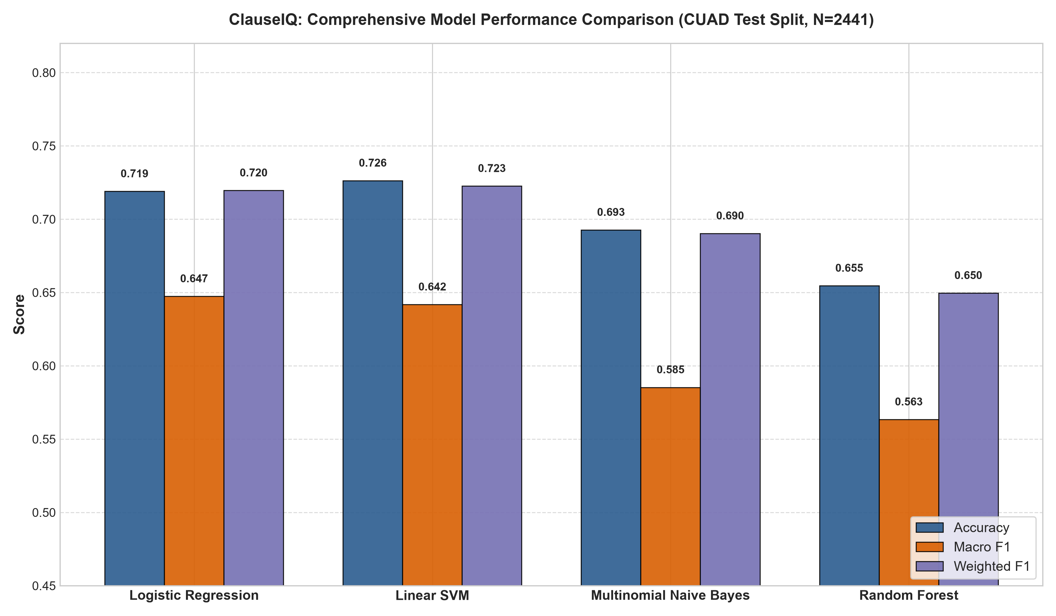
COMPARISON
MODEL COMPARISON VISUAL BENCHMARK
Accuracy vs. Macro-F1 across All Four Architectures
KEY TAKEAWAYS
SVM:
Highest Accuracy
72.63%
Logistic Regression:
Highest Macro-F1
64.74%
NB / RF:
Lower Macro-F1
(58.53% / 56.34%)
ClauseIQ — Contract Clause Classification & Intelligent Search
Dept. of Computer Applications, MACE | Slide 13
Notes:
Slide 13 displays the model comparison bar chart generated at 300 DPI from results/model_comparison.png.
The chart visually shows the comparison across Accuracy, Macro-F1, and Weighted-F1:
Linear SVM leads in raw Accuracy with 72.63%.
Logistic Regression leads in Macro-F1 with 64.74%.
Both Naive Bayes and Random Forest lag significantly behind in Macro-F1, showing that linear models handle sparse high-dimensional TF-IDF vectors much better than tree ensembles.

Slide 14
SELECTION
MODEL SELECTION: WHY LOGISTIC REGRESSION?
Selection Decision Based on Primary Evaluation Metric
LINEAR SVM
Accuracy: 72.63% (Highest Accuracy)
Macro-F1: 64.18%
LOGISTIC REGRESSION
Accuracy: 71.90%
Macro-F1: 64.74% (Highest Macro-F1)
PRIMARY METRIC: MACRO-F1
SELECTED MODEL: LOGISTIC REGRESSION
Macro-F1 gives equal importance to all 41 classes regardless of sample frequency.
ClauseIQ — Contract Clause Classification & Intelligent Search
Dept. of Computer Applications, MACE | Slide 14
Notes:
Slide 14 explains our model selection decision.
Our evaluation strategy defined Macro-F1 as the primary metric and Accuracy as the secondary metric.
Linear SVM achieved a higher raw accuracy of 72.63% compared to 71.90% for Logistic Regression.
However, Logistic Regression achieved a higher Macro-F1 of 64.74% compared to 64.18% for Linear SVM.
In an imbalanced 41-class dataset, Macro-F1 is essential because it gives equal importance to rare, high-consequence clauses like Price Restrictions and Non-Compete, rather than being dominated by frequent boilerplate.
Therefore, Logistic Regression was selected because Macro-F1 was defined as the primary evaluation metric.

Slide 15
PER-CLASS
CLASS-LEVEL PERFORMANCE
Representative Category Metrics from Logistic Regression Report
Category | Precision | Recall | F1-Score
Governing Law | 100.00% | 96.74% | 98.34%
Parties | 97.19% | 96.80% | 96.99%
Insurance | 97.25% | 94.64% | 95.93%
Cap On Liability | 79.46% | 65.93% | 72.06%
Affiliate License-Licensee | 21.95% | 39.13% | 28.12%
Affiliate License-Licensor | 11.11% | 21.43% | 14.63%
Performance varies significantly across categories due to class imbalance and vocabulary overlap.
ClauseIQ — Contract Clause Classification & Intelligent Search
Dept. of Computer Applications, MACE | Slide 15
Notes:
Slide 15 shows class-level results from our verified classification report in results/classification_reports/logistic_regression_report.csv across six representative categories:
Distinctive categories like Governing Law and Parties achieve near-perfect F1-scores of 98.34% and 96.99%.
Moderate provisions like Cap On Liability achieve 72.06% F1.
Challenging provisions such as Affiliate License-Licensee and Licensor achieve lower F1-scores (28.12% and 14.63%) because they share virtually identical vocabulary, differing only in who grants the license to whom.

Slide 16
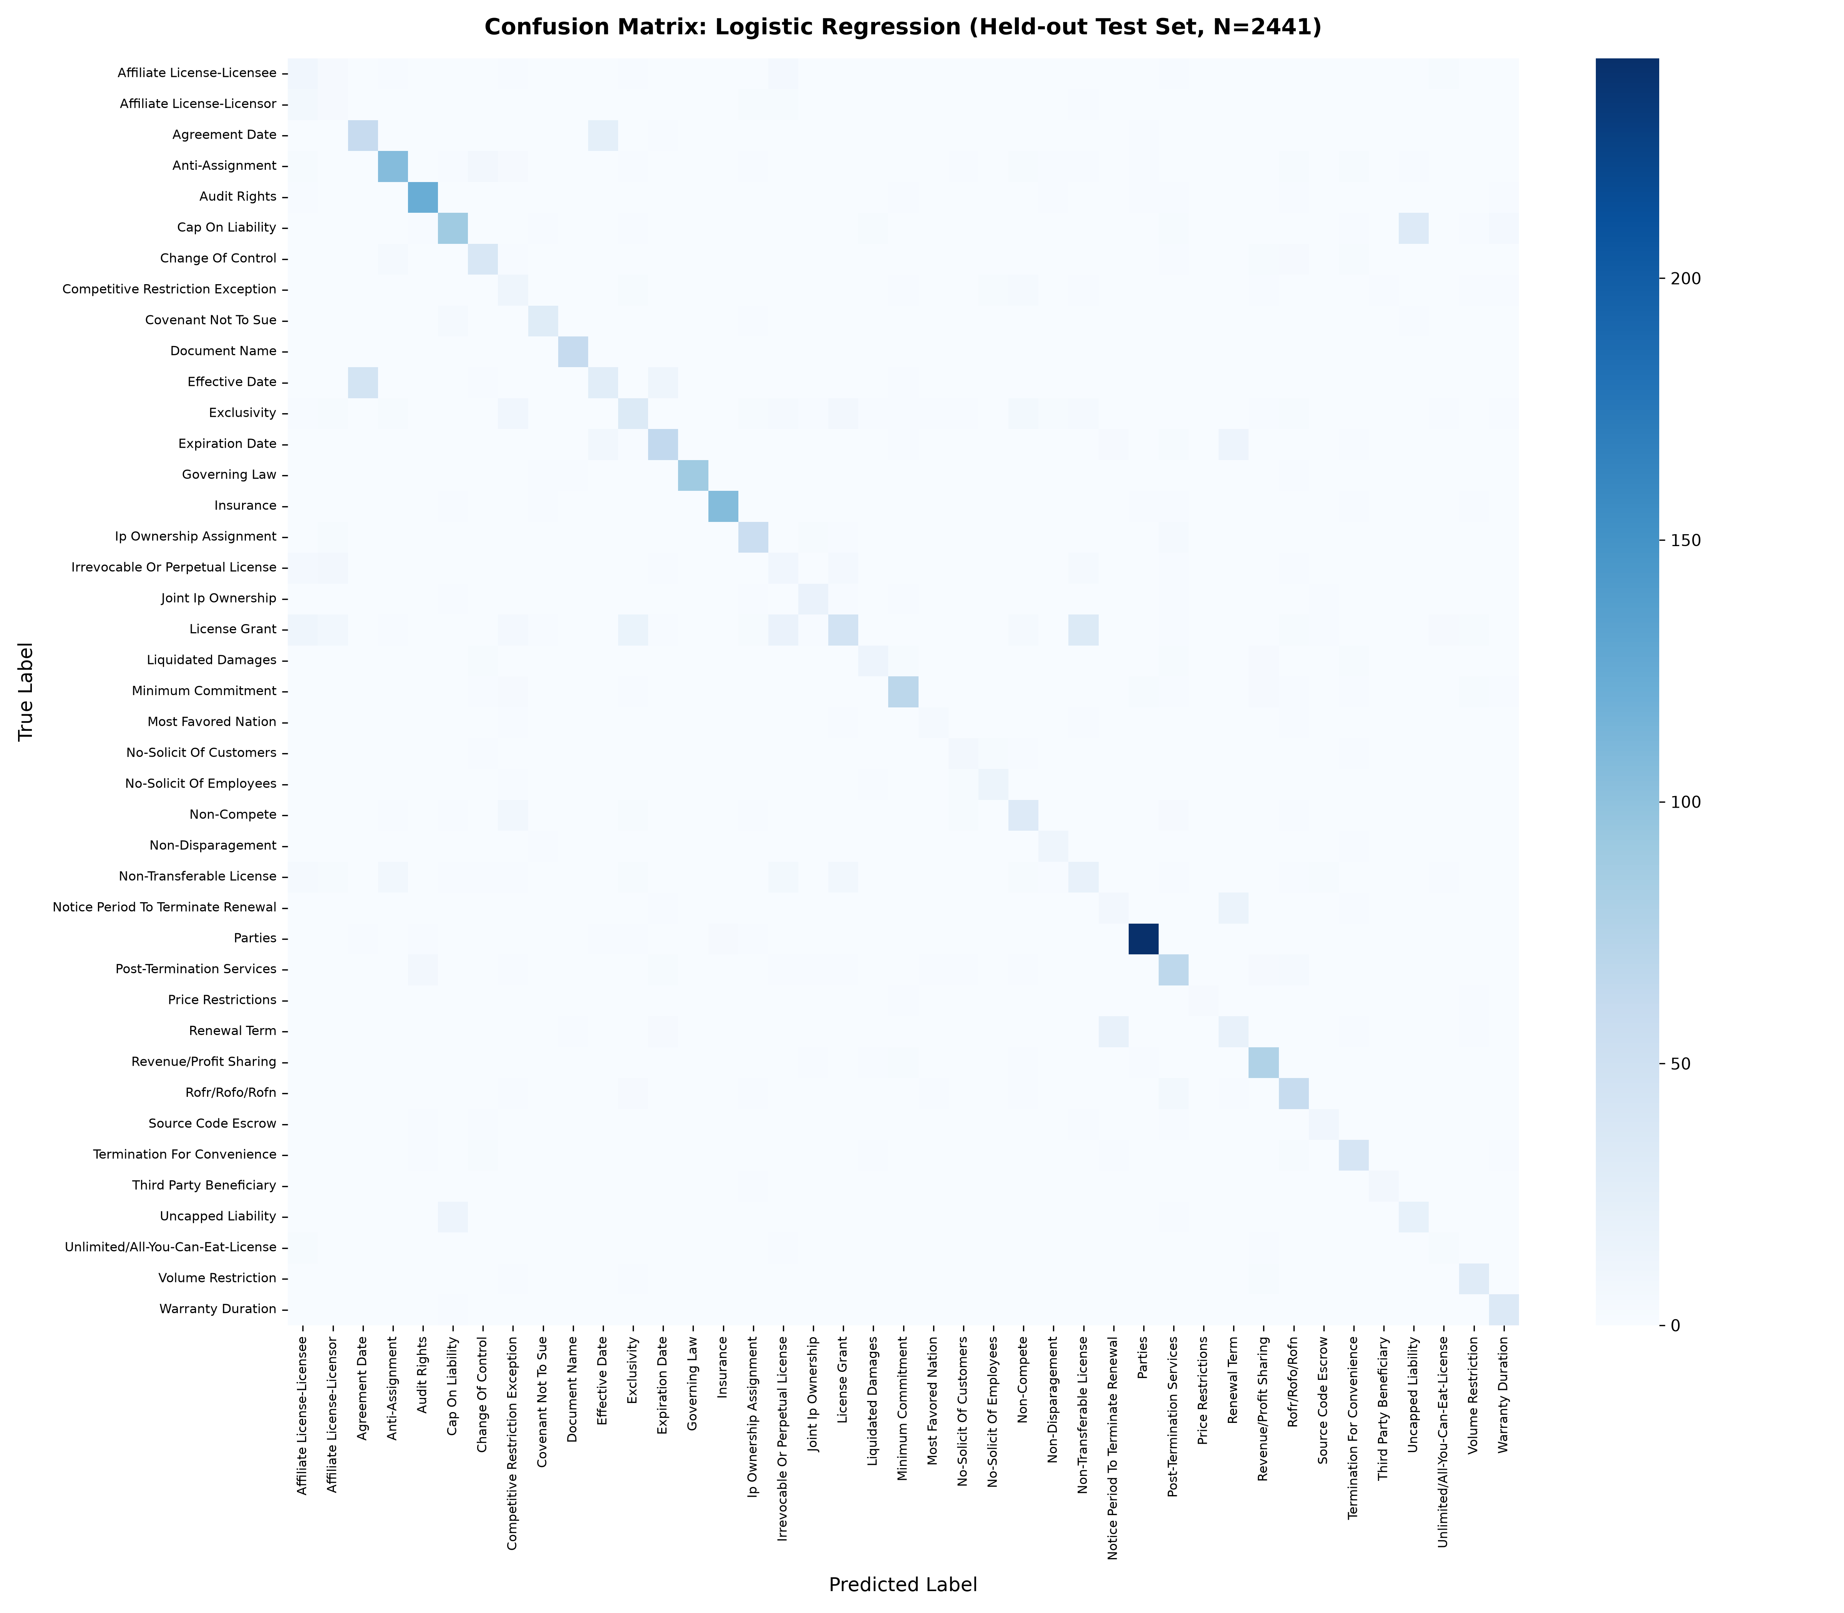
ERROR ANALYSIS
CONFUSION MATRIX ANALYSIS
41 x 41 Error Analysis for Logistic Regression (Test N = 2,441)
41 x 41 MATRIX
• Rows = True Labels
• Columns = Predicted
• Diagonal = Correct
• Off-diagonal = Errors
Most errors occur between classes with similar legal wording (e.g., Licensee vs. Licensor).
ClauseIQ — Contract Clause Classification & Intelligent Search
Dept. of Computer Applications, MACE | Slide 16
Notes:
Slide 16 displays the full 41-by-41 confusion matrix for Logistic Regression on our held-out test set of 2,441 samples.
The vertical axis shows True Categories, and the horizontal axis shows Predicted Categories.
The bright diagonal confirms high accuracy on frequent provisions.
Off-diagonal errors are concentrated in specific pairs with similar wording, such as Affiliate License-Licensee versus Licensor, Cap On Liability versus Uncapped Liability, and Agreement Date versus Effective Date.

Slide 17
RETRIEVAL & FINDINGS
SEARCH PROTOTYPE & KEY FINDINGS
TF-IDF Semantic Retrieval Results and Core ML Insights
SEARCH PROTOTYPE
TF-IDF + Cosine Similarity
• Precision@1 = 80%
• Precision@5 = 88%
• Precision@10 = 86%
KEY FINDINGS
✓ Linear models performed better on sparse TF-IDF features
✓ Macro-F1 is essential for the imbalanced dataset
✓ Similar legal vocabulary causes classification errors
✓ Bigrams are critical for capturing legal collocations
BIGRAM ABLATION:
Precision@1 drops 80% → 60% without bigrams
ClauseIQ — Contract Clause Classification & Intelligent Search
Dept. of Computer Applications, MACE | Slide 17
Notes:
Slide 17 summarizes our search prototype and core machine learning insights.
In our search evaluation using TF-IDF and Cosine Similarity, the retrieval engine achieves 80% Precision@1, 88% Precision@5, and 86% Precision@10.
Our ablation experiment confirmed that bigrams are essential: without bigrams, Precision@1 drops by 20% (from 80% to 60%).
Our key machine learning takeaways are:
First, linear models handle sparse text spaces much better than tree ensembles;
Second, Macro-F1 is essential for an imbalanced legal dataset;
And third, vocabulary overlap is the primary source of classification confusion.

Slide 18
STATUS & NEXT
CURRENT STATUS & NEXT STEPS
Interim Completed Scope vs. Upcoming Final Milestones
COMPLETED ✓
• Dataset & EDA
• Preprocessing pipeline
• TF-IDF feature space
• 4 ML models trained & tuned
• Model evaluation
• Logistic Regression selected
• Confusion matrix analysis
• Search prototype + ablation
• FastAPI prototype
NEXT PHASE →
• Supabase integration
• React.js user interface
• End-to-end integration
• Cloud deployment
• Final validation & testing
ClauseIQ — Contract Clause Classification & Intelligent Search
Dept. of Computer Applications, MACE | Slide 18
Notes:
Slide 18 provides an honest interim progress audit:
On the left, completed tasks include dataset validation, preprocessing, TF-IDF vectorization, training and tuning all four models, multi-metric evaluation, model selection of Logistic Regression, confusion matrix analysis, search prototype, and our FastAPI backend.
On the right, work scheduled for our final phase includes connecting the live Supabase database, building the React user interface, conducting end-to-end integration testing, and final cloud deployment.

Slide 19
THANK YOU
Questions & Discussion
ClauseIQ
Machine Learning-Based Contract Clause Classification
and Intelligent Search System
Mohammed Farhan K | MAC25MCA-2042 | MACE
Notes:
Thank you very much, respected evaluators and guide, for your time and feedback.
ClauseIQ has completed its core machine learning phase with verified empirical results, achieving 64.74% Macro-F1 with Logistic Regression across 41 imbalanced legal categories, alongside a verified search prototype.
I welcome your questions, feedback, and suggestions for our upcoming final phase.

